Slide 1
Redwoods
Dr. Swagato Chatterjee
VGSOM IITKGP

Slide 2
About Rosewood
International hotel and resort management company
Age 25 years
Privately held
A number of key executives
Small number of properties (12 properties, 1513 rooms)
Luxury segment facing increasing competition
Heterogeneous properties

Slide 3
Hotels and Resorts
Corporate Chains
Individually branded hotels
Low avg daily rate
High occupancy
High avg daily rate
Low occupancy

Slide 4
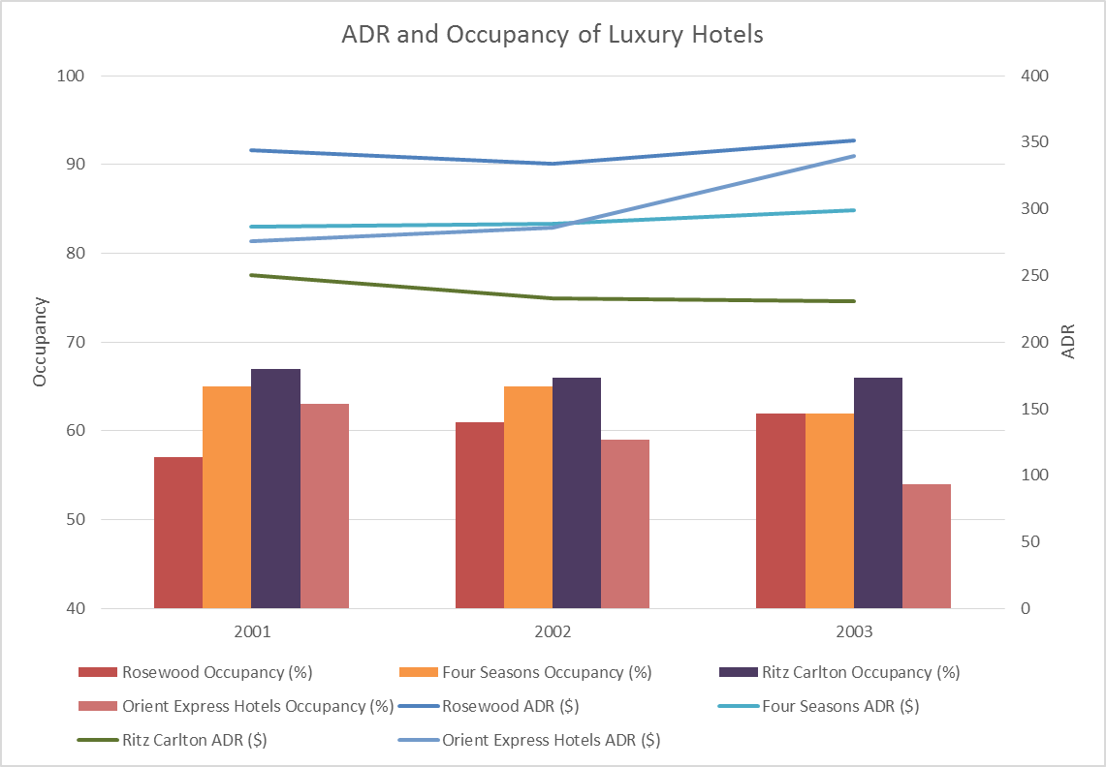

Slide 5
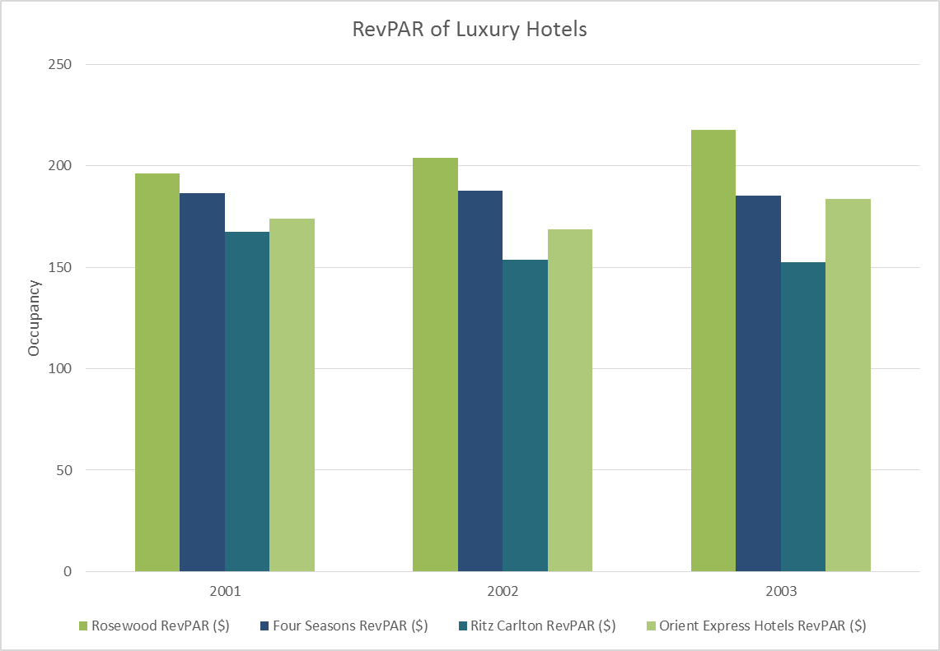

Slide 6
Rosewoods Branding Strategy
Individual branding of unique properties
Property specific ads
Soft branding of Rosewood name
“Sense of Place”
Flexible service and product standards
Large margin

Slide 7
Rosewood Customer Base
Small (115000) Niche Market
Wealthy ($750 avg daily spend)
Avg revenue per guest ( 2 days stay ) is $1500
Not very loyal (17% retention rate)
Very low multi-property customers (5%)
Unaware of Rosewood Brand. Loyal to individual brands
Rosewood brand awareness through the travel agents

Slide 8
Business Problem?

Slide 9
Individual vs Corporate Brands
 | IB | CB
Pros | Differentiate from Luxury Brands IB provides higher ADR and RevPAR Well established IBs | Encourage cross sell Operational economies of scale Marketing costs will reduce
Cons | Deters multi property cross selling Narrow brand positioning | Needs consistency Dillema with uniqueness and individuality CB may deter some customers and managers Significant investments

Slide 10
CLV Calculation

Slide 11
After Story
2004: Rosewood Hotel / Rosewood Resorts / Rosewood University / Rosewood Orientation
2005: Rosewood ubiquitous name
2006: Slow change for well established hotel brands, Rosewood lifestyle, Showing results
2007: Successful Corporate Branding

